Slide 1
Simple JSP programs

Slide 2
An Example for JSP

Slide 3
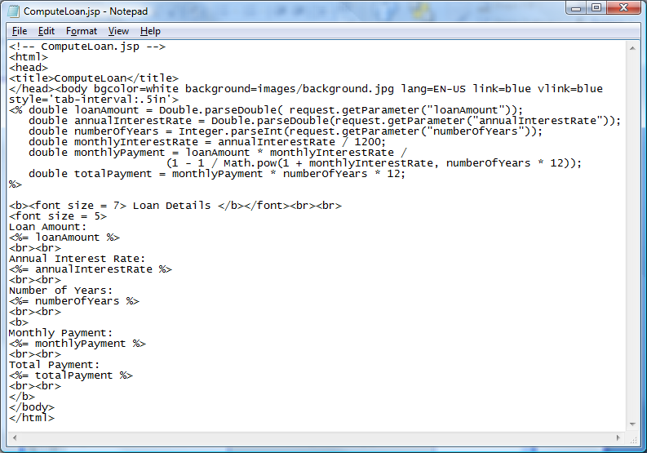
Scripting Example
Java statements
Java expression
ComputeLoan.jsp

Slide 4
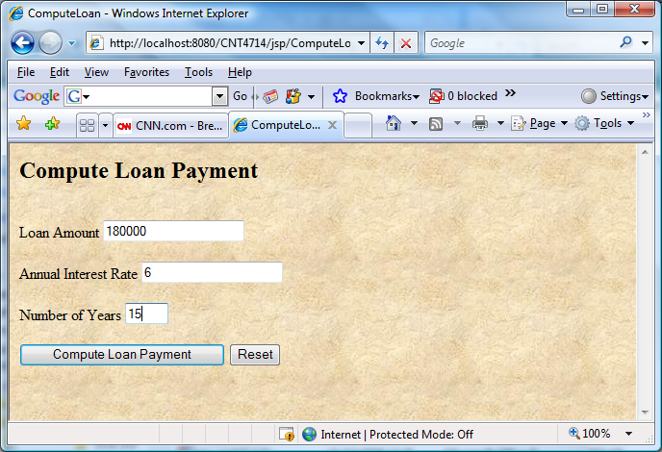
Scripting Example

Slide 5
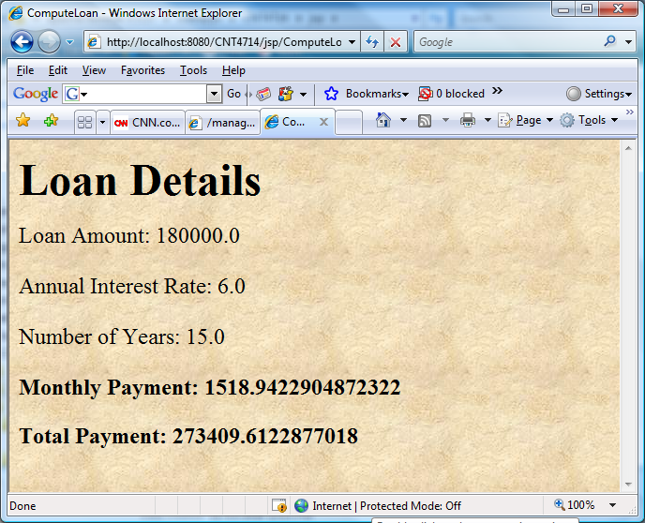
Scripting Example

Slide 6
Scripting Example Using Directives
package code; public class Loan { private double annualInterestRate; private int numOfYears; private double loanAmount; private java.util.Date loanDate; /** Default constructor */ public Loan() { this(7.5, 30, 100000); } /** Construct a loan with specified annual interest rate, number of years and loan amount */ public Loan(double annualInterestRate, int numOfYears, double loanAmount) { this.annualInterestRate = annualInterestRate; this.numOfYears = numOfYears; this.loanAmount = loanAmount; loanDate = new java.util.Date(); }

Slide 7
/** Return annualInterestRate */ public double getAnnualInterestRate() { return annualInterestRate; } /** Set a new annualInterestRate */ public void setAnnualInterestRate(double annualInterestRate) { this.annualInterestRate = annualInterestRate; } /** Return numOfYears */ public int getNumOfYears() { return numOfYears; } /** Set a new numOfYears */ public void setNumOfYears(int numOfYears) { this.numOfYears = numOfYears; } /** Return loanAmount */ public double getLoanAmount() { return loanAmount; }

Slide 8
/** Set a newloanAmount */ public void setLoanAmount(double loanAmount) { this.loanAmount = loanAmount; } /** Find monthly payment */ public double monthlyPayment() { double monthlyInterestRate = annualInterestRate / 1200; return loanAmount * monthlyInterestRate / (1 - (Math.pow(1 / (1 + monthlyInterestRate), numOfYears * 12))); } /** Find total payment */ public double totalPayment() { return monthlyPayment() * numOfYears * 12; } /** Return loan date */ public java.util.Date getLoanDate() { return loanDate; } }

Slide 9
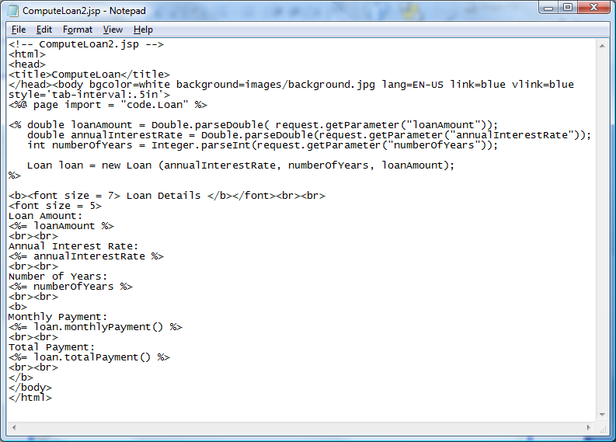
Scripting Example
JSP directive to include a Java class.

Slide 10
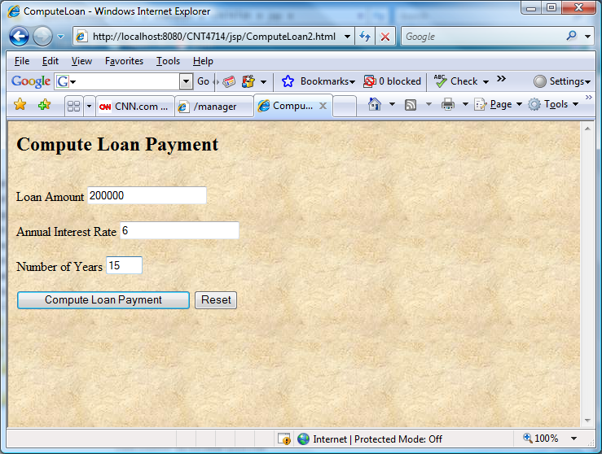
Scripting Example Using Directives

Slide 11
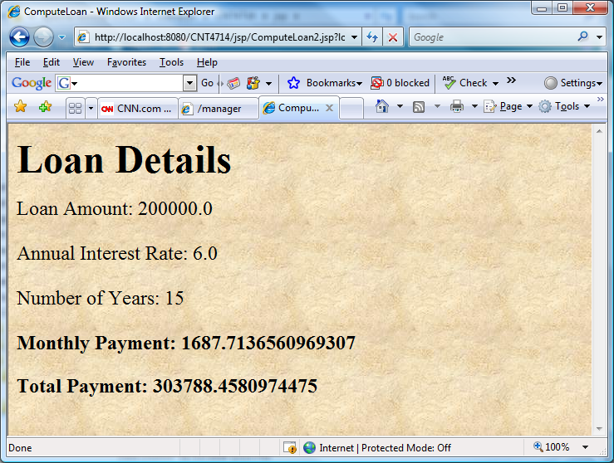
Scripting Example Using Directives

Slide 12
A JSP Using the <jsp: include> Action
<?xml version = "1.0"?>
<!DOCTYPE html PUBLIC "-//W3C//DTD XHTML 1.0 Strict//EN"
"http://www.w3.org/TR/xhtml1/DTD/xhtml1-strict.dtd">
<!-- include.jsp -->
<html xmlns = "http://www.w3.org/1999/xhtml">
<head>
<title>Using jsp:include</title>
<style type = "text/css">
body {
font-family: tahoma, helvetica, arial, sans-serif;
}
table, tr, td {
font-size: 1.1em;
border: 3px groove;
padding: 5px;
background-color: #dddddd;
}
</style>
</head>

Slide 13
<body>
<table>
<tr>
<td style = "width: 250px; text-align: center">
<img src = "smallucf.gif"
width = "140" height = "93"
alt = "pegasus logo" />
</td>
<td>
<%-- include banner.html in this JSP --%>
<jsp:include page = "banner.html"
flush = "true" />
</td>
</tr>
<tr>
<td style = "width: 250px">
<%-- include toc.html in this JSP --%>
<jsp:include page = "toc.html" flush = "true" />
</td>
<td style = "vertical-align: top">
<%-- include clock2.jsp in this JSP --%>
<jsp:include page = "clock2.jsp"
flush = "true" />
</td>
</tr>
</table>
</body>
</html>

Slide 14
Banner.html
<!-- banner.html -->
<!-- banner to include in another document -->
<div style = "width: 800px">
<p>
CNT 4714 - Enterprise Computing
<br />
Fall 2008 Semester - University of Central Florida
</p>
<p>
<a href = "mailto:markl@cs.ucf.edu">markl@cs.ucf.edu</a>
</p>
</div>

Slide 15
Table of Contents (toc.html)
<!-- toc.html -->
<!-- contents to include in another document -->
<p><a href = "http://www.cs.ucf.edu/courses/cnt4714/fall2008">
CNT 4714 Course Webpage
</a></p>
<p><a href = "http://www.cs.ucf.edu/faculty/markl.html">
Instructor's Webpage
</a></p>
<p><a href = "http://www.cs.ucf.edu/courses/cnt4714/fall2008/code.html">
Code Download Page
</a></p>
<p><a href = "http://www.cs.ucf.edu/courses/cnt4714/fall2008/homework.html">
Programming Assignments Page
</a></p>
<p>Send questions or comments about this site to
<a href = "mailto:markl@cs.ucf.edu">
markl@cs.ucf.edu
</a><br />
</p>

Slide 16
Clock2.jsp
<!-- clock2.jsp -->
<!-- date and time to include in another document via redirection -->
<table>
<tr>
<td style = "background-color: black;">
<p class = "big" style = "color: cyan; font-size: 3em;
font-weight: bold;">
<%-- script to determine client local and --%>
<%-- format date accordingly --%>
<%
// get client locale
java.util.Locale locale = request.getLocale();
// get DateFormat for client's Locale
java.text.DateFormat dateFormat =
java.text.DateFormat.getDateTimeInstance(
java.text.DateFormat.LONG,
java.text.DateFormat.LONG, locale );
%> <%-- end script --%>
<%-- output date --%>
<%= dateFormat.format( new java.util.Date() ) %>
</p>
</td>
</tr>
</table>

Slide 17
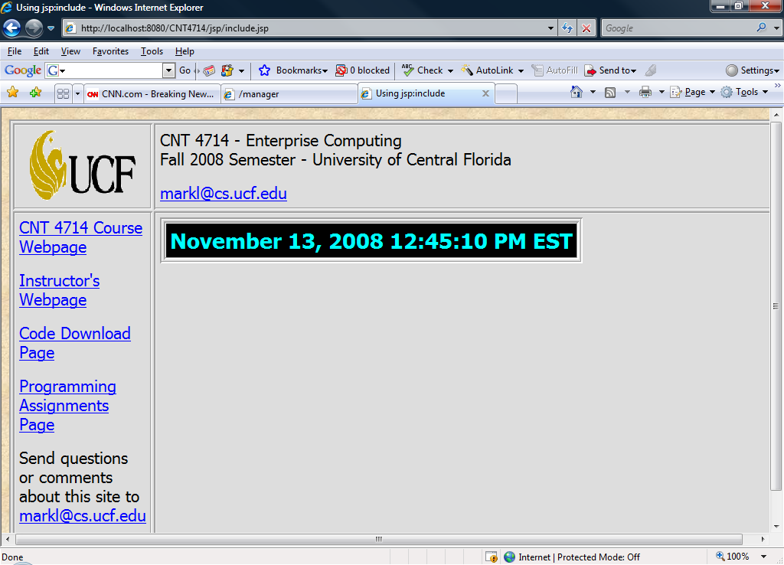
Execution of include.jsp

Slide 18
<jsp: forward> Action
JSP action <jsp: forward> enables a JSP to forward request processing to a different resource, such as an error page.
Request processing by the original JSP terminates as soon as the JSP forwards the request.
In the next example, this action is illustrated by forwarding a welcome request to another welcome page. JSP forward1.jsp forwards the request to JSP forward2.jsp. The forwarding action requests a date and time at which the original request was received that is forwarded.

Slide 19
Initial Forward JSP (forward1.jsp)
<?xml version = "1.0"?>
<!DOCTYPE html PUBLIC "-//W3C//DTD XHTML 1.0 Strict//EN"
"http://www.w3.org/TR/xhtml1/DTD/xhtml1-strict.dtd">
<!-- forward1.jsp -->
<html xmlns = "http://www.w3.org/1999/xhtml">
<head>
<title>Forward request to another JSP</title>
</head>
<body>
<% // begin scriptlet
String name = request.getParameter( "firstName" );
if ( name != null )
{
%> <%-- end scriptlet to insert fixed template data --%>
<jsp:forward page = "forward2.jsp">
<jsp:param name = "date"
value = "<%= new java.util.Date() %>" />
</jsp:forward>
<% // continue scriptlet
} // end if

Slide 20
Initial Forward JSP (forward1.jsp) (cont.)
else
{
%> <%-- end scriptlet to insert fixed template data --%>
<form action = "forward1.jsp" method = "get">
<p>Type your first name and press Submit</p>
<p><input type = "text" name = "firstName" />
<input type = "submit" value = "Submit" />
</p>
</form>
<% // continue scriptlet
} // end else
%> <%-- end scriptlet --%>
</body>
</html> <!-- end XHTML document -->

Slide 21
Forward2 JSP (forward2.jsp)
<?xml version = "1.0"?>
<!DOCTYPE html PUBLIC "-//W3C//DTD XHTML 1.0 Strict//EN"
"http://www.w3.org/TR/xhtml1/DTD/xhtml1-strict.dtd">
<!-- forward2.jsp -->
<html xmlns = "http://www.w3.org/1999/xhtml">
<head>
<title>Processing a forwarded request</title>
<style type = "text/css">
.big
{
font-family: tahoma, helvetica, arial, sans-serif;
font-weight: bold;
font-size: 2em;
}
</style>
</head>
<body>
<p class = "big">
Hello <%= request.getParameter( "firstName" ) %>, <br />
Your redirection request was received <br /> and forwarded at

Slide 22
Forward2 JSP (forward2.jsp) (cont.)
</p>
<table style = "border: 6px outset;">
<tr>
<td style = "background-color: black;">
<p class = "big" style = "color: cyan;">
<%= request.getParameter( "date" ) %>
</p>
</td>
</tr>
</table>
</body>
</html>

Slide 23
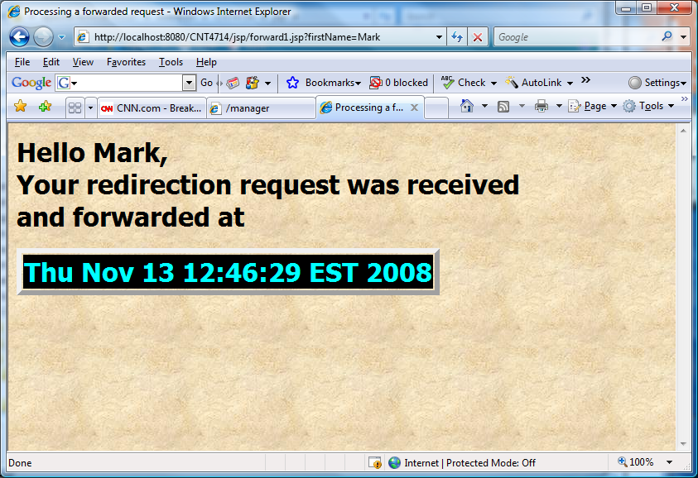
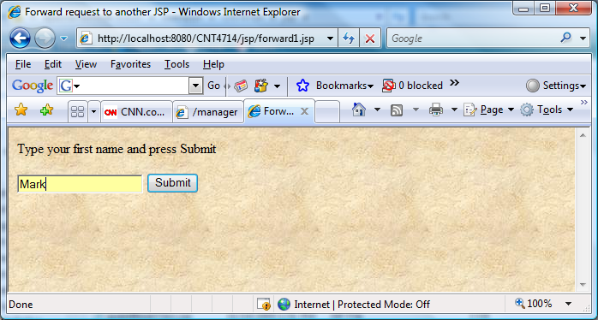
Forward2.jsp receives forwarded request for service with firstname passed as a parameter
Original request is invoked by forward1.jsp

Slide 24
Example Loan Calculator
Gets input to compute loan from user →
index.jsp
Header.jsp
Footer.jsp
Selects the right jsp for calculating loan →
controller.jsp
Computes loan based on simple interest
simple.jsp
Header.jsp
Footer.jsp
compound.jsp
Computes loan based on simple interest
error.jsp
Calculate loan
error.jsp
Calculate loan
Handles error if exception is thrown
Handles error if exception is thrown
Notes:
Potential Damages:
1. Change orders placed by the client (Instead of 500 widgets he can make the order 50,000 widgets)
2. Change meeting venues to send people on wild goose chases

Slide 25
Loan Calculator index.jsp
<html>
<head>
<title>Include</title>
</head>
<body style="font-family:verdana;font-size:10pt;">
<%@ include file="header.html" %>
<form action="controller.jsp">
<table border="0" style="font-family:verdana;font-size:10pt;">
<tr>
<td>Amount:</td>
<td><input type="text" name="amount" />
</tr>
<tr>
<td>Interest in %:</td>
<td><input type="text" name="interest"/></td>
</tr>
<tr>
<td>Compound:</td>
<td><input type="radio" name="type" value="C" checked/></td>
</tr>
<tr>
<td>Simple:</td>
<td><input type="radio" name="type" value="S" /></td>
</tr>
<tr>
<td>Period:</td>
<td><input type="text" name="period"/></td>
</tr>
</table>
<input type="submit" value="Calculate"/>
</form>
<jsp:include page="footer.jsp"/>
</body>
</html>
Notes:
Potential Damages:
1. Change orders placed by the client (Instead of 500 widgets he can make the order 50,000 widgets)
2. Change meeting venues to send people on wild goose chases

Slide 26
Loan Calculator Miscelaneous
controller.jsp
<%
String type = request.getParameter("type");
if(type.equals("S")) {
%>
<jsp:forward page="/simple.jsp"/>
<%
} else {
%>
<jsp:forward page="/compound.jsp"/>
<%
}
%>
error.jsp
<%@ page isErrorPage="true" %>
<html>
<head>
<title>Simple</title>
</head>
<body style="font-family:verdana;font-size:10pt;">
<%@ include file="header.html" %>
<p style="color=#FF0000"><b><%= exception.getMessage() %></b></p>
<jsp:include page="footer.jsp"/>
</body>
</html>
header.jsp
<h3>Loan Calculator</h3>
footer.jsp
<%= new java.util.Date() %>
Notes:
Potential Damages:
1. Change orders placed by the client (Instead of 500 widgets he can make the order 50,000 widgets)
2. Change meeting venues to send people on wild goose chases

Slide 27
Loan Calculator simple.jsp
<%@ page errorPage="error.jsp" %>
<%!
public double calculate(double amount, double interest, int period) {
if(amount <= 0) {
throw new IllegalArgumentException("Amount should be greater than 0: " + amount);
}
if(interest <= 0) {
throw new IllegalArgumentException("Interest should be greater than 0: " + interest);
}
if(period <= 0) {
throw new IllegalArgumentException("Period should be greater than 0: " + period);
}
return amount*(1 + period*interest/100);
}
%>
<html>
<head>
<title>Simple</title>
</head>
<body style="font-family:verdana;font-size:10pt;">
<%@ include file="header.html" %>
<%
double amount = Double.parseDouble(request.getParameter("amount"));
double interest = Double.parseDouble(request.getParameter("interest"));
int period = Integer.parseInt(request.getParameter("period"));
%>
<b>Pincipal using simple interest:</b>
<%= calculate(amount, interest, period) %>
<br/><br/>
<jsp:include page="footer.jsp"/>
</body>
</html>
Notes:
Potential Damages:
1. Change orders placed by the client (Instead of 500 widgets he can make the order 50,000 widgets)
2. Change meeting venues to send people on wild goose chases

Slide 28
Loan Calculator compound.jsp
<%@ page errorPage="error.jsp" %>
<%!
public double calculate(double amount, double interest, int period) {
if(amount <= 0) {
throw new IllegalArgumentException("Amount should be greater than 0: " + amount);
}
if(interest <= 0) {
throw new IllegalArgumentException("Interest should be greater than 0: " + interest);
}
if(period <= 0) {
throw new IllegalArgumentException("Period should be greater than 0: " + period);
}
return amount*Math.pow(1 + interest/100, period);
}
%>
<html>
<head>
<title>Compound</title>
</head>
<body style="font-family:verdana;font-size:10pt;">
<%@ include file="header.html" %>
<%
double amount = Double.parseDouble(request.getParameter("amount"));
double interest = Double.parseDouble(request.getParameter("interest"));
int period = Integer.parseInt(request.getParameter("period"));
%>
<b>Pincipal using compound interest:</b>
<%= calculate(amount, interest, period) %>
<br/><br/>
<jsp:include page="footer.jsp"/>
</body>
</html>
Notes:
Potential Damages:
1. Change orders placed by the client (Instead of 500 widgets he can make the order 50,000 widgets)
2. Change meeting venues to send people on wild goose chases

Slide 29
Example Inventory
Runs the SQL query for listing inventory
ListServlet
Takes the RowSet in the context and renders it
List.jsp
Renders form for new item
Runs SQL query to get a record from item
Deletes a record from the item table
EditServlet
New.html
DeleteServlet
Takes a RowSet and renders a form for editing
Edit.jsp
CreateServlet
Runs SQL query to update the data in the item table after editing
Runs SQL query to create new record
UpdateServlet
Notes:
Potential Damages:
1. Change orders placed by the client (Instead of 500 widgets he can make the order 50,000 widgets)
2. Change meeting venues to send people on wild goose chases

Slide 30
Inventory ListServlet
package edu.albany.mis.goel.servlets;
import javax.servlet.ServletException;
import javax.servlet.ServletConfig;
import javax.servlet.http.HttpServlet;
import javax.servlet.http.HttpServletRequest;
import javax.servlet.http.HttpServletResponse;
import javax.sql.DataSource;
import javax.sql.RowSet;
import sun.jdbc.rowset.CachedRowSet;
public class ListServlet extends HttpServlet {
public void init(ServletConfig config) throws ServletException {
super.init(config);
}
public void doPost(HttpServletRequest req, HttpServletResponse res)
throws ServletException {
doGet(req, res);
}
public void doGet(HttpServletRequest req, HttpServletResponse res)
throws ServletException {
try {
// Load the driver class
Class.forName("sun.jdbc.odbc.JdbcOdbcDriver");
// Define the data source for the driver
String sourceURL = "jdbc:odbc:inventoryDB";
RowSet rs = new CachedRowSet();
rs.setUrl(sourceURL);
rs.setCommand("select * from item");
rs.execute();
req.setAttribute("rs", rs);
getServletContext().getRequestDispatcher("/List.jsp").
forward(req, res);
} catch(Exception ex) {
throw new ServletException(ex);
}
}
}
Notes:
Potential Damages:
1. Change orders placed by the client (Instead of 500 widgets he can make the order 50,000 widgets)
2. Change meeting venues to send people on wild goose chases

Slide 31
Inventory EditServlet
package edu.albany.mis.goel.servlets;
import javax.servlet.ServletException;
import javax.servlet.ServletConfig;
import javax.servlet.http.HttpServlet;
import javax.servlet.http.HttpServletRequest;
import javax.servlet.http.HttpServletResponse;
import java.sql.DriverManager;
import javax.sql.DataSource;
import javax.sql.RowSet;
import sun.jdbc.rowset.CachedRowSet;
public class EditServlet extends HttpServlet {
public void init(ServletConfig config) throws ServletException {
super.init(config);
}
public void doPost(HttpServletRequest req, HttpServletResponse res)
throws ServletException {
doGet(req, res);
}
public void doGet(HttpServletRequest req, HttpServletResponse res)
throws ServletException {
try {
// Load the driver class
Class.forName("sun.jdbc.odbc.JdbcOdbcDriver");
// Define the data source for the driver
String sourceURL = "jdbc:odbc:inventoryDB";
RowSet rs = new CachedRowSet();
rs.setUrl(sourceURL);
rs.setCommand("select * from item where id = ?");
rs.setInt(1, Integer.parseInt(req.getParameter("id")));
rs.execute();
req.setAttribute("rs", rs);
getServletContext().getRequestDispatcher("/Edit.jsp").forward(req, res);
} catch(Exception ex) {
throw new ServletException(ex);
}
}
}
Notes:
Potential Damages:
1. Change orders placed by the client (Instead of 500 widgets he can make the order 50,000 widgets)
2. Change meeting venues to send people on wild goose chases

Slide 32
Inventory UpdateServlet
package edu.albany.mis.goel.servlets;
import javax.servlet.ServletException;
import javax.servlet.ServletConfig;
import javax.servlet.http.HttpServlet;
import javax.servlet.http.HttpServletRequest;
import javax.servlet.http.HttpServletResponse;
import javax.sql.DataSource;
import javax.naming.InitialContext;
import java.sql.DriverManager;
import java.sql.Connection;
import java.sql.PreparedStatement;
import java.sql.ResultSet;
public class UpdateServlet extends HttpServlet {
public void init(ServletConfig config) throws ServletException {
super.init(config);
}
public void doPost(HttpServletRequest req, HttpServletResponse res)
throws ServletException {
doGet(req, res);
}
public void doGet(HttpServletRequest req, HttpServletResponse res)
throws ServletException {
Connection con = null;
try {
// Load the driver class
Class.forName("sun.jdbc.odbc.JdbcOdbcDriver");
// Define the data source for the driver
String sourceURL = "jdbc:odbc:inventoryDB";
// Create a connection through the DriverManager class
con = DriverManager.getConnection(sourceURL);
System.out.println("Connected Connection");
PreparedStatement stmt= con.prepareStatement
("update item " + "set name = ?, " + "description = ?, " + "price = ?, "
+ "stock = ? " + "where id = ?");
stmt.setString(1, req.getParameter("name"));
stmt.setString(2, req.getParameter("description"));
stmt.setDouble(3, Double.parseDouble(req.getParameter("price")));
stmt.setInt(4, Integer.parseInt(req.getParameter("stock")));
stmt.setInt(5, Integer.parseInt(req.getParameter("id")));
stmt.executeUpdate();
stmt.close();
getServletContext().getRequestDispatcher("/List").
forward(req, res);
} catch(Exception ex) {
throw new ServletException(ex);
} finally {
try {
if(con != null) {
con.close();
}
} catch(Exception ex) {
throw new ServletException(ex);
}
}
}
}
Notes:
Potential Damages:
1. Change orders placed by the client (Instead of 500 widgets he can make the order 50,000 widgets)
2. Change meeting venues to send people on wild goose chases

Slide 33
Inventory DeleteServlet
package edu.albany.mis.goel.servlets;
import javax.servlet.ServletException;
import javax.servlet.ServletConfig;
import javax.servlet.http.HttpServlet;
import javax.servlet.http.HttpServletRequest;
import javax.servlet.http.HttpServletResponse;
import javax.sql.DataSource;
import javax.naming.InitialContext;
import java.sql.Connection;
import java.sql.DriverManager;
import java.sql.PreparedStatement;
import java.sql.ResultSet;
public class DeleteServlet extends HttpServlet {
public void init(ServletConfig config) throws ServletException {
super.init(config);
}
public void doPost(HttpServletRequest req, HttpServletResponse res)
throws ServletException {
doGet(req, res);
}
public void doGet(HttpServletRequest req, HttpServletResponse res)
throws ServletException {
Connection con = null;
try {
// Load the driver class
Class.forName("sun.jdbc.odbc.JdbcOdbcDriver");
// Define the data source for the driver
String sourceURL = "jdbc:odbc:inventoryDB";
// Create a connection through the DriverManager class
con = DriverManager.getConnection(sourceURL);
System.out.println("Connected Connection");
// Create Statement
PreparedStatement stmt =
con.prepareStatement("delete from item where id = ?");
stmt.setInt(1, Integer.parseInt(req.getParameter("id")));
stmt.executeUpdate();
stmt.close();
getServletContext().getRequestDispatcher("/List").
forward(req, res);
} catch(Exception ex) {
throw new ServletException(ex);
} finally {
try {
if(con != null) con.close();
} catch(Exception ex) {
throw new ServletException(ex);
}
}
}
}
Notes:
Potential Damages:
1. Change orders placed by the client (Instead of 500 widgets he can make the order 50,000 widgets)
2. Change meeting venues to send people on wild goose chases

Slide 34
Inventory CreateServlet
package edu.albany.mis.goel.servlets;
import javax.servlet.ServletException;
import javax.servlet.ServletConfig;
import javax.servlet.http.HttpServlet;
import javax.servlet.http.HttpServletRequest;
import javax.servlet.http.HttpServletResponse;
import javax.sql.DataSource;
import javax.naming.InitialContext;
import java.sql.DriverManager;
import java.sql.Connection;
import java.sql.PreparedStatement;
import java.sql.ResultSet;
public class CreateServlet extends HttpServlet {
public void init(ServletConfig config) throws ServletException {
super.init(config);
}
public void doPost(HttpServletRequest req, HttpServletResponse res)
throws ServletException {
doGet(req, res);
}
public void doGet(HttpServletRequest req, HttpServletResponse res)
throws ServletException {
Connection con = null;
try { // Load the driver class
Class.forName("sun.jdbc.odbc.JdbcOdbcDriver");
// Define the data source for the driver
String sourceURL = "jdbc:odbc:inventoryDB";
// Create a connection through the DriverManager class
con = DriverManager.getConnection(sourceURL);
System.out.println("Connected Connection");
PreparedStatement stmt = con.prepareStatement
("insert into item " + "(name,description,price,stock) " +
"values (?, ?, ?, ?)");
stmt.setString(1, req.getParameter("name"));
stmt.setString(2, req.getParameter("description"));
stmt.setDouble(3, Double.parseDouble(req.getParameter("price")));
stmt.setInt(4, Integer.parseInt(req.getParameter("stock")));
stmt.executeUpdate();
stmt.close();
getServletContext().getRequestDispatcher("/List").forward(req, res);
} catch(Exception ex) {
throw new ServletException(ex);
} finally {
try {
if(con != null) con.close();
} catch(Exception ex) {
throw new ServletException(ex);
}
}
}
}
Notes:
Potential Damages:
1. Change orders placed by the client (Instead of 500 widgets he can make the order 50,000 widgets)
2. Change meeting venues to send people on wild goose chases

Slide 35
Inventory Edit.jsp
<%@page contentType="text/html"%>
<jsp:useBean id="rs" scope="request" type="javax.sql.RowSet" />
<html>
<head>
<title>Inventory - Edit</title>
</head>
<body style="font-family:verdana;font-size:10pt;">
<%
if(rs.next()) {
%>
<form action="Update">
<input name="id" type="hidden" value="<%= rs.getString(1) %>"/>
<table cellpadding="5" style="font-family:verdana;font-size:10pt;">
<tr>
<td><b>Name:</b></td>
<td>
<input name="name" type="text" value="<%= rs.getString(2) %>"/>
</td>
</tr>
<tr>
<td><b>Description:</b></td>
<td>
<input name="description" type="text" value="<%= rs.getString(3) %>"/>
</td>
</tr>
<tr>
<td><b>Price:</b></td>
<td>
<input name="price" type="text" value="<%= rs.getString(4) %>"/>
</td>
</tr>
<tr>
<td><b>Stock:</b></td>
<td>
<input name="stock" type="text" value="<%= rs.getString(5) %>"/>
</td>
</tr>
<tr>
<td></td>
<td>
<input type="submit" value="Update"/>
</td>
</tr>
</table>
<%
}
%>
</body>
</html>
Notes:
Potential Damages:
1. Change orders placed by the client (Instead of 500 widgets he can make the order 50,000 widgets)
2. Change meeting venues to send people on wild goose chases

Slide 36
Inventory Edit.jsp
<%@page contentType="text/html"%>
<jsp:useBean id="rs" scope="request" type="javax.sql.RowSet" />
<html>
<head>
<title>Inventory - List</title>
</head>
<body style="font-family:verdana;font-size:10pt;">
<table cellpadding="5" style="font-family:verdana;font-size:10pt;">
<tr>
<th>Name</th>
<th>Description</th>
<th>Price</th>
<th>Stock</th>
<th></th>
<th></th>
</tr>
<%
while(rs.next()) {
%>
<tr>
<td><%= rs.getString(2) %></td>
<td><%= rs.getString(3) %></td>
<td><%= rs.getString(4) %></td>
<td><%= rs.getString(5) %></td>
<td>
<a href="Delete?id=<%= rs.getString(1) %>">
Delete
</a>
</td>
<td>
<a href="Edit?id=<%= rs.getString(1) %>">
Edit
</a>
</td>
</tr>
<%
}
%>
</table>
<a href="New.html">New Item</a>
</body>
</html>
Notes:
Potential Damages:
1. Change orders placed by the client (Instead of 500 widgets he can make the order 50,000 widgets)
2. Change meeting venues to send people on wild goose chases

Slide 37
Inventory New.html
<html>
<head>
<title>Inventory - Add New Item</title>
</head>
<body style="font-family:verdana;font-size:10pt;">
<form action="Create">
<table cellpadding="5" style="font-family:verdana;font-size:10pt;">
<tr>
<td><b>Name:</b></td>
<td><input name="name" type="text"/></td>
</tr>
<tr>
<td><b>Description:</b></td>
<td><input name="description" type="text"/></td>
</tr>
<tr>
<td><b>Price:</b></td>
<td><input name="price" type="text"/></td>
</tr>
<tr>
<td><b>Stock:</b></td>
<td><input name="stock" type="text"/></td>
</tr>
<tr>
<td></td>
<td><input type="submit" value="Create"/></td>
</tr>
</table>
</body>
</html>
Notes:
Potential Damages:
1. Change orders placed by the client (Instead of 500 widgets he can make the order 50,000 widgets)
2. Change meeting venues to send people on wild goose chases

Slide 38
JSP - Database Access
Understanding on how JDBC application works.
Before starting with database access through a JSP, make sure that you have proper JDBC environment setup along with a database.

Slide 39
Steps to creatd JDBC
Tables creation
Load the driver manager
Connection establishment
Statement creations
Process the result set
Execute the statement
Close the connection and statement
Stop the program

Slide 40
Creating a Database Table
String table ;
table= "CREATE TABLE Employee11(Emp_code integer, Emp_name varchar(10))";
st.executeUpdate(table);

Slide 41
Connection Establishment
Is an interface in java.sql package Specifies connection with specific database like: MySQL, Ms-Access, Oracle etc and java files.
The SQL statements are executed within the context of the Connection interface.
Class.forName(String driver):

Slide 42
Connection Establishment
Syntax
Connection conn; Class.forname(“com.mysql.jdbc.Driver”).newInstance();

Slide 43
DriverManager
It is a class of java.sql package that controls a set of JDBC drivers.
Each driver has to be register with this class.
getConnection(String url, String userName, String password):
url: - Database url where stored or created your database
userName: - User name of MySQL
password: -Password of MySQL

Slide 44
Load the JDBC Driver into the database
Syntax
String userName = "root";
String password = "mysql";
String url = "jdbc:mysql://localhost/programs";
conn = DriverManager.getConnection(url,userName,password);

Slide 45
Create the statements and update the values in the table structure
Statement st=conn.createStatement();
st.execute("create table stud10(rollno int,name text,m1 int,m2 int)");
st.executeUpdate("insert into stud10 values(2,'rani',50,90)");

Slide 46
Process the Query result set
rs=st.executeQuery("select * from stud10");
while(rs.next())
{
System.out.println(rs.getInt(1));
System.out.println(rs.getString(2));
System.out.println(rs.getInt(3));
System.out.println(rs.getInt(4));
}

Slide 47
Close the connection
con.close():
This method is used for disconnecting the connection.
It frees all the resources occupied by the database.

Slide 48
Close the statement and connection
st.close();
conn.close();

Slide 49
Create Table
mysql> use TEST;
mysql> create table Employees ( id int not null, age int not null, first varchar (255), last varchar (255) );
Query OK, 0 rows affected (0.08 sec)
mysql>
Create Data Records
mysql> INSERT INTO Employees VALUES (100, 18, 'Zara', 'Ali');
Query OK, 1 row affected (0.05 sec)
mysql> INSERT INTO Employees VALUES (101, 25, 'Mahnaz', 'Fatma');
Query OK, 1 row affected (0.00 sec)

Slide 50
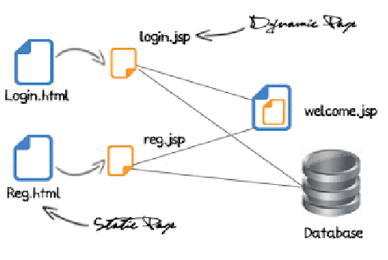
Connecting JSP To Mysql Database

Slide 51
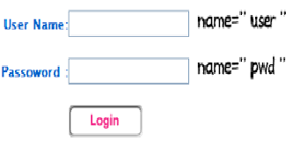
Login.html
<body> <form action="login.jsp" method="post"> User name :<input type="text" name="usr" /> password :<input type="password" name="pwd" /> <input type="submit" /></form></body>

Slide 52
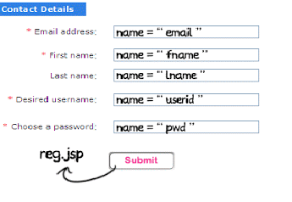
Reg.html
<form action="reg.jsp" method="post“> Email :<input type="text" name="email" /> First name :<input type="text" name="fname" /> Last name :<input type="text" name="lname" /> User name :<input type="text" name="userid" /> password :<input type="password" name="pwd" /> <input type="submit" /></form>

Slide 53
Login.jsp
<%@ page import ="java.sql.*" %> <%@ page import ="javax.sql.*" %> <% String userid=request.getParameter("user"); session.putValue("userid",userid); String pwd=request.getParameter("pwd"); Class.forName("com.mysql.jdbc.Driver"); java.sql.Connection con = DriverManager.getConnection("jdbc:mysql://localhost:3306/ test","root","root"); Statement st= con.createStatement(); ResultSet rs=st.executeQuery("select * from users where user_id='"+userid+"'"); if(rs.next()) { if(rs.getString(2).equals(pwd)) { out.println("welcome"+userid); } else { out.println("Invalid password try again"); } } else %>

Slide 54
Reg.jsp
<%@ page import ="java.sql.*" %> <%@ page import ="javax.sql.*" %><% String user=request.getParameter("userid"); session.putValue("userid",user); String pwd=request.getParameter("pwd"); String fname=request.getParameter("fname"); String lname=request.getParameter("lname"); String email=request.getParameter("email"); Class.forName("com.mysql.jdbc.Driver"); java.sql.Connection con = DriverManager.getConnection("jdbc:mysql://localhost:3306/test", "root","root"); Statement st= con.createStatement(); ResultSet rs; int i=st.executeUpdate("insert into users values ('"+user+"','"+pwd+"','"+fname+"', '"+lname+"','"+email+"')"); %>

Slide 55
Index.html
<HTML> <HEAD>
<TITLE>Database Lookup</TITLE> </HEAD> <BODY> <H1>Database Lookup</H1>
<FORM ACTION="basic.jsp" METHOD="POST"> Please enter the ID of the publisher you want to find: <BR>
<INPUT TYPE="TEXT" NAME="id"> <BR>
<INPUT TYPE="SUBMIT" value="Submit"> </FORM> </BODY>
<HTML>

Slide 56
Basic.jsp
<%@ page import="java.sql.*" %>
<% Class.forName("sun.jdbc.odbc.JdbcOdbcDriver"); %><HTML> <HEAD> <TITLE>Fetching Data From a Database</TITLE> </HEAD>
<BODY> <H1>Fetching Data From a Database</H1>
<% Connection connection = DriverManager.getConnection( "jdbc:odbc:data", "YourName", "password");
Statement statement = connection.createStatement(); String id = request.getParameter("id");
ResultSet resultset = statement.executeQuery("select * from Publishers where pub_id = '" + id + "'") ;
if(!resultset.next()) { out.println("Sorry, could not find that publisher. "); } else { %>

Slide 57
Basic.jsp
<TABLE BORDER="1"> <TR> <TH>ID</TH> <TH>Name</TH> <TH>City</TH> <TH>State</TH> <TH>Country</TH> </TR> <TR> <TD>
<%= resultset.getString(1) %> </TD> <TD>
<%= resultset.getString(2) %> </TD> <TD>
<%= resultset.getString(3) %> </TD> <TD>
<%= resultset.getString(4) %> </TD> <TD>
<%= resultset.getString(5) %> </TD> </TR>
</TABLE> <BR> <% } %>
</BODY> </HTML>

Slide 58
JSP in XML
JSP can be embedded in XML as well as in HTML
Due to XML’s syntax rules, the tags must be different (but they do the same things)
HTML: <%= expression %> XML: <jsp:expression>expression</jsp:expression>
HTML: <% code %> XML: <jsp:scriptlet>code</jsp:scriptlet>
HTML: <%! declarations %> XML: <jsp:declaration>declarations</jsp:declaration>
HTML: <%@ include file=URL %> XML: <jsp:directive.include file="URL"/>

Slide 59
Sending XML from a JSP
<%@ page contentType="text/xml" %>
File Content:
<%@ page contentType="text/xml" %> <books>
<book> <name>Padam History</name> <author>ZARA</author>
<price>100</price> </book>
</books>

Slide 60
Processing XML in JSP
Books.xml
<books> <book> <name>Padam History</name> <author>ZARA</author> <price>100</price> </book> <book> <name>Great Mistry</name> <author>NUHA</author> <price>2000</price> </book>
</books>

Slide 61
<%@ taglib uri="http://java.sun.com/jsp/jstl/core" prefix="c" %>
<%@ taglib uri="http://java.sun.com/jsp/jstl/sql" prefix="sql"%>
<html>
<head>
<title>sql:setDataSource Tag</title>
</head>
<body>
<sql:setDataSource var="db" driver="com.mysql.jdbc.Driver"
url="jdbc:mysql://localhost/test"
user="root" password="1234"/>
</body>
</html>

Slide 62
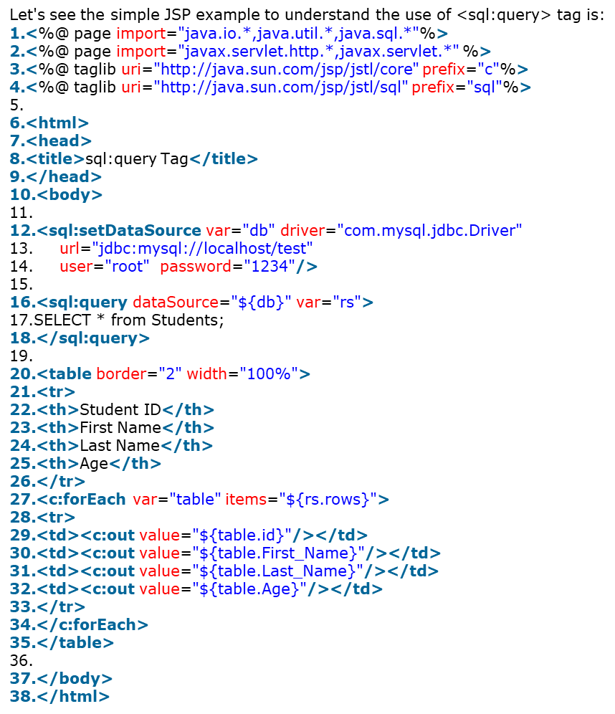

Slide 63
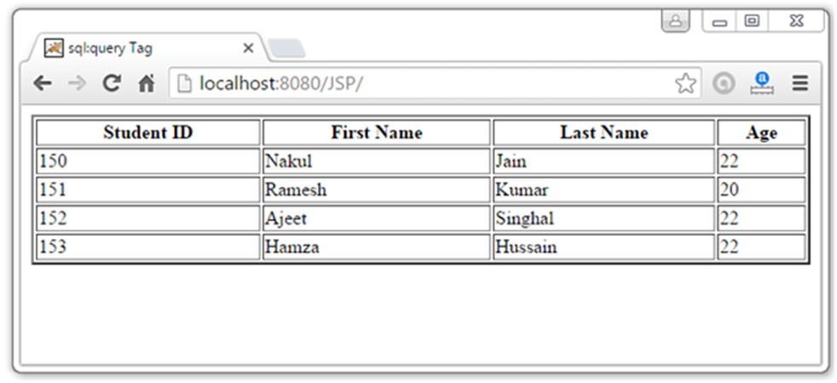

Slide 64
Let's see the simple JSP example to understand the use of <sql:update> tag is:
<%@ page import="java.io.*,java.util.*,java.sql.*"%>
<%@ page import="javax.servlet.http.*,javax.servlet.*" %>
<%@ taglib uri="http://java.sun.com/jsp/jstl/core" prefix="c"%>
<%@ taglib uri="http://java.sun.com/jsp/jstl/sql" prefix="sql"%>
<html>
<head>
<title>sql:update Tag</title>
</head>
<body>
<sql:setDataSource var="db" driver="com.mysql.jdbc.Driver"
url="jdbc:mysql://localhost/test"
user="root" password="1234"/>
<sql:update dataSource="${db}" var="count">
INSERT INTO Students VALUES (154,'Nasreen', 'jaha', 25);
</sql:update>
<sql:query dataSource="${db}" var="rs">
SELECT * from Students;
</sql:query>

Slide 65
<table border="2" width="100%">
<tr>
<th>Student ID</th>
<th>First Name</th>
<th>Last Name</th>
<th>Age</th>
</tr>
<c:forEach var="table" items="${rs.rows}">
<tr>
<td><c:out value="${table.id}"/></td>
<td><c:out value="${table.First_Name}"/></td>
<td><c:out value="${table.Last_Name}"/></td>
<td><c:out value="${table.Age}"/></td>
</tr>
</c:forEach>
</table>
</body>
</html>

Slide 66
